Slide 1
Tackling Chaos, Resilence & Metrics in the heart of your Application
Alberto Acerbis

Slide 2
un ringraziamento a

Slide 3
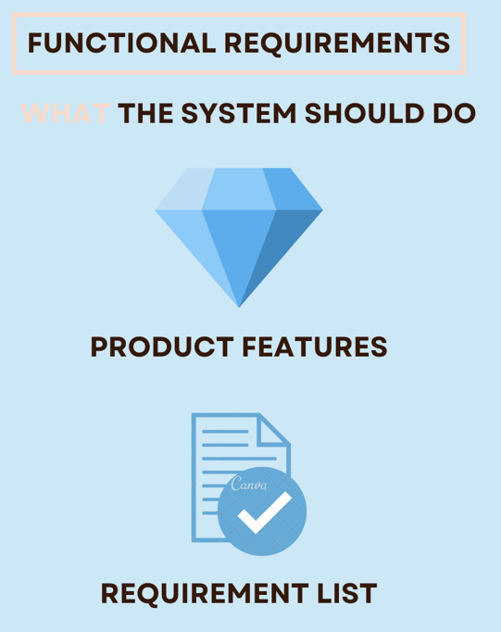
Functional Requirements

Slide 4
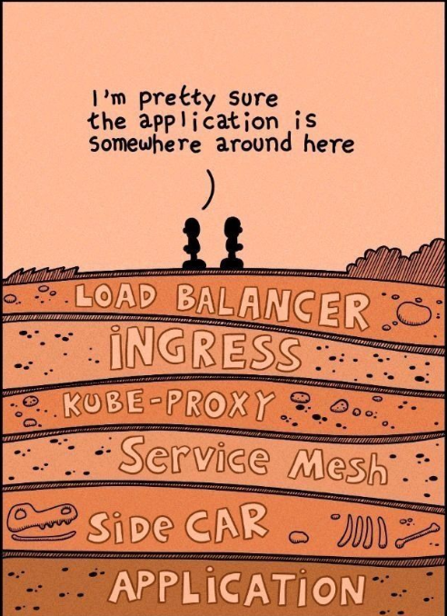
Where is my Application?

Slide 5
Non-Functional Requirements

Slide 6
Distributed System
A distributed system is a network of independent computers that work together as a single system to solve a problem or execute a task
In a distributed system, each computer, also known as a node, has its own memory and processing capabilities and communicates with other nodes through a network.
These systems are designed to distribute the workload among multiple nodes, which can lead to increase performance, fault tolerance, and scalability compared to centralized systems.

Slide 7
Distributed System
A distributed system is a network of independent computers that work together as a single system to solve a problem or execute a task
In a distributed system, each computer, also known as a node, has its own memory and processing capabilities and communicates with other nodes through a network.
These systems are designed to distribute the workload among multiple nodes, which can lead to increase performance, fault tolerance, and scalability compared to centralized systems.

Slide 8
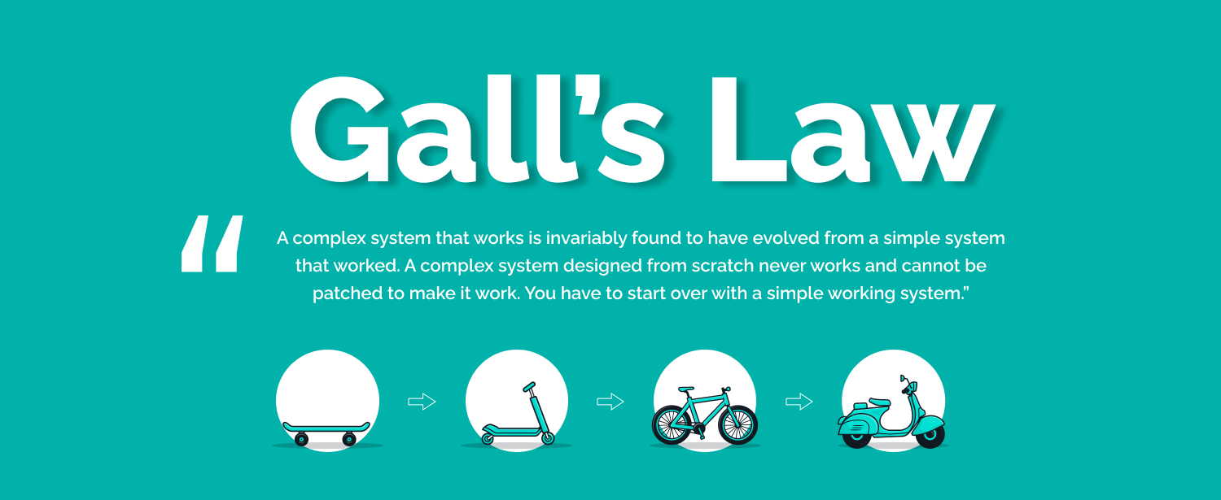
The Gall’s Law

Slide 9
The 3 Pillars of Observability

Slide 10
The 3 Pillars of Observability
Metrics are data measured or acquired from the individual components of a network.
Latency and traffic in a network, error and discard rates, and saturation data acquired from network devices all contribute to metrics.
Traces give you the step-by-step approach an application takes in executing a specific functionality. They help you identify the lowest performing functions or components in an application, help in troubleshooting, and provide critical visibility into the behavior and overall health of an application
Logs record events that occur in a system. Be it system logs or application logs, recording and analyzing the acquired logs will help you determine the events and actions occurring in the system

Slide 11
Built-in ASP.NET Core Metrics
Metrics built-in for ASP.NET Core using System.Diagnostics.Metrics API
Microsoft.AspNetCore.Hosting | Report high-level information about HTTP request received by ASP.NET Core
Microsoft.AspNetCore.Routing | Report information about routing HTTP requests to ASP.NET Core endpoints
Microsoft.AspNetCore.Diagnostics | Report diagnostics information from ASP.NET Core error handling middleware
Microsoft.AspNetCore.RateLimiting | Report rate limiting information from ASP.NET Core rate-limiting middleware
Microsoft.AspNetCore.HeaderParsing | Report information about ASP.NET Core header parsing
Microsoft.AspNetCore.Kestrel | Report HTTP connection information from ASP.NET Core kestrel web server
Microsoft.AspNetCore.Http.Connections | Report connection information from ASP.NET Core SignalR

Slide 12
Using Metrics
Instrumentation
Code in .NET libraries takes measurements and associates these measurements with a metric name.
.NET and ASP.NET Core include many built-in metrics.
Collection
A .NET application configures named metrics to be transmitted from the application for external storage and analysis.

Slide 13
Observability approaches in .NET
Explicity in code
By referencing and using OpenTelemetry.
Out-of-Process
Using EventPipe and tools such as dotnet-monitor.
Using a startup hook
Injecting assemblies into the process (OpenTelemetry .NET Automatic Instrumentation).

Slide 14
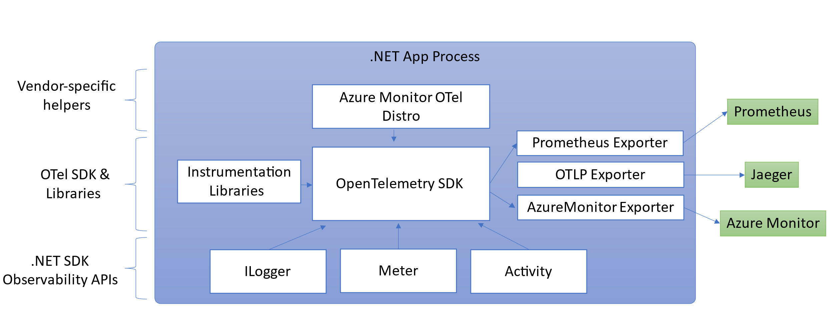
.NET and OpenTelemetry
.NET Observability with OpenTelemetry - .NET | Microsoft Learn

Slide 15
Populating metrics in Grafana with OpenTelemetry and Prometheus

Slide 16
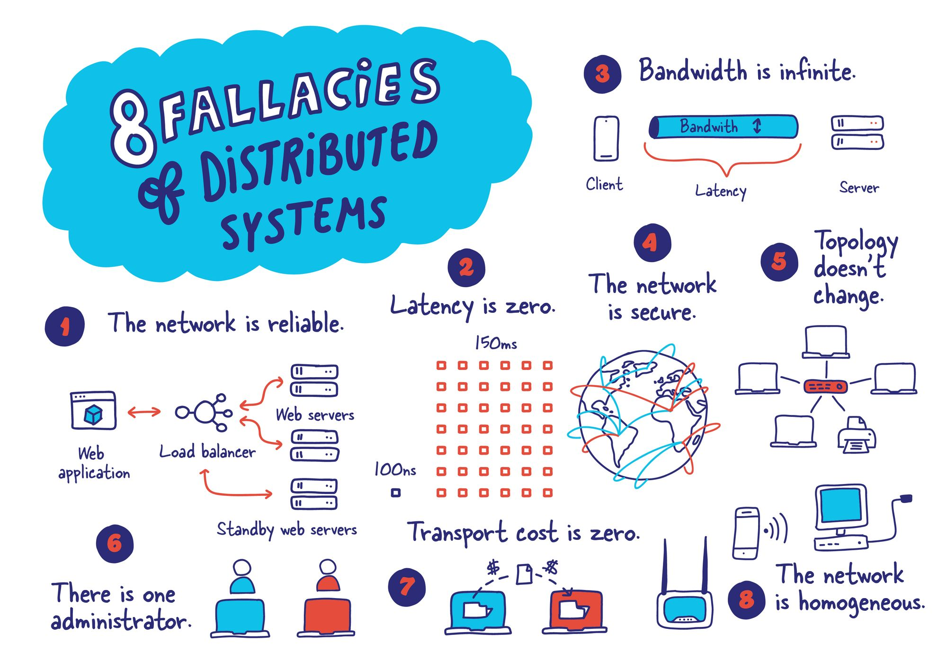

Slide 17
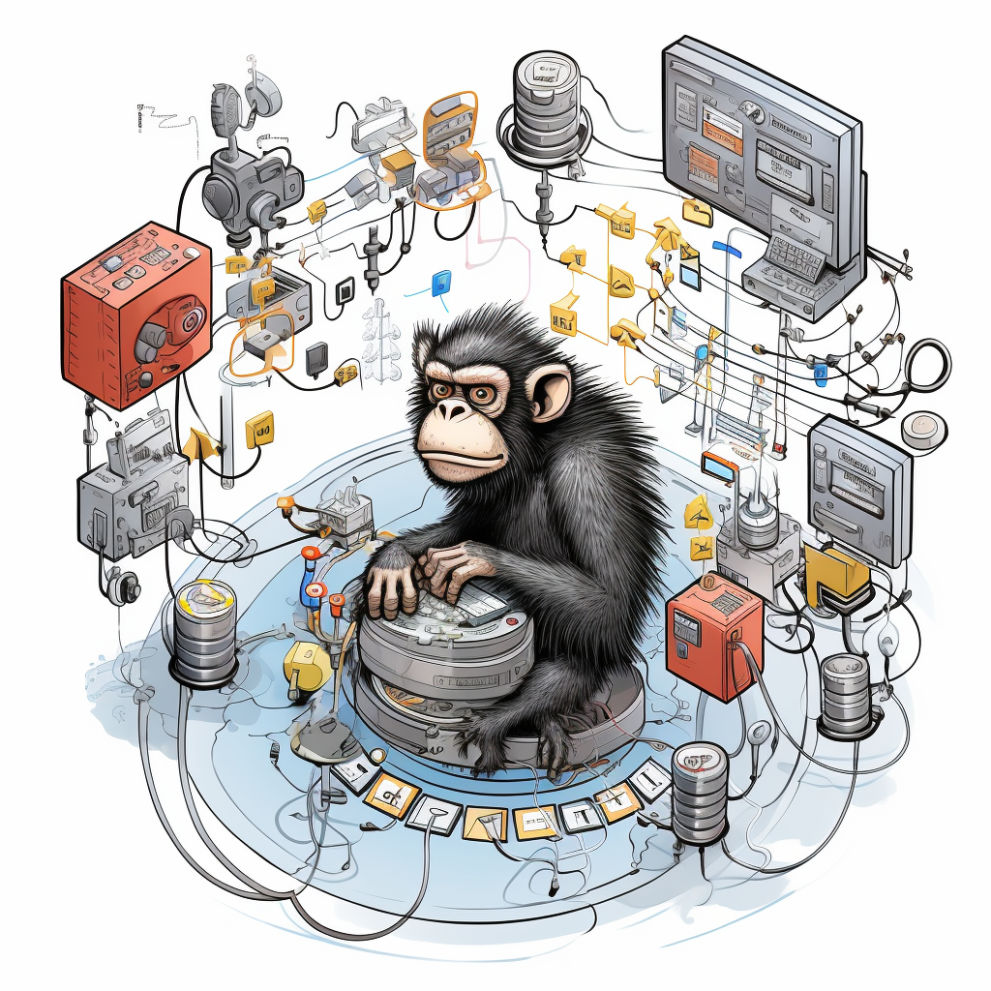
Chaos Engineering

Slide 18
What is Chaos Engineering?
Chaos Engineering is the discipline of experimenting on a system in order to build confidence in the system’s capability to withstand turbulent conditions in productions.
Principles of Chaos
Chaos Engineering lets you compare what you think will happen to what actually happens in your systems. You literally «break thins on purpose» to learn how to build more resilient system.
Gremlin

Slide 19
Principles of Chaos Engineering
Define a Steady state
What normal looks like for your system.
Plan an Experiment
Create a hyphotesis. What could go wrong?
Contain the Blast Radius
Execute the smallest test that will teach you something
Scale or squash
Find an issue? Job weel done! NO? Increase the blast radius

Slide 20
Resilience Strategies
Strategy | Premise | AKA | How does strategy mitigate?
Retry | Many faults are transient and may self-correct after a short delay. | Maybe it's just a blip | Allows configuring automatic retries.
Circuit-breaker | When a system is seriously struggling, failing fast is better than making users/callers wait. Protecting a faulting system from overload can help it recover. | Stop doing it if it hurts Give that system a break | Breaks the circuit (blocks executions) for a period, when faults exceed some pre-configured threshold.
Fallback | Things will still fail - plan what you will do when that happens. | Degrade gracefully | Defines an alternative value to be returned (or action to be executed) on failure.
Hedging | Things can be slow sometimes, plan what you will do when that happens. | Hedge your bets | Executes parallel actions when things are slow and waits for the fastest one.

Slide 21
Built-in Strategies
Strategy | Type | What does the strategy do?
Fault | Proactive | Injects exceptions in your system.
Outcome | Reactive | Injects fake outcomes (results or exceptions) in your system
Latency | Proactive | Injects latency into executions before the calls are made
Behavior | Proactive | Allow you to inject any extra behavior, before a call is placed

Slide 22
Chaos and Resilience with

Slide 23
Is Chaos the only way?
Chaos Engineering is focused on systems already running in production and has its focus on technology and infrastructure.
The goal of Residuality Theory is improved operations and, as ther is no running infrastructure, is not accessible to architects at design-time.

Slide 24
Residuality Theory
A random simulation of stress is a better way of generating a software architecture than prediction, requirements analysis, reuse of patterns, or reactive change management by coding.

Slide 25
Looking for Stressor
A stressor is any fact about the context that is currently unknown to you.

Slide 26
How It Works?
Implement a naive architecture
Looking for Stressors
Implement the Residual Architecture

Slide 27
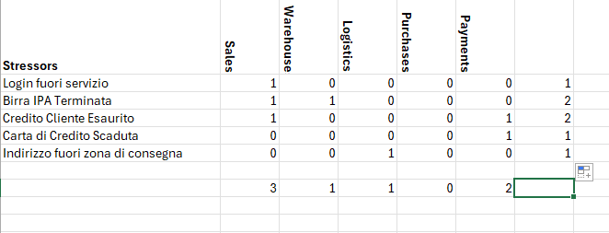
Stressors Analysis

Slide 28
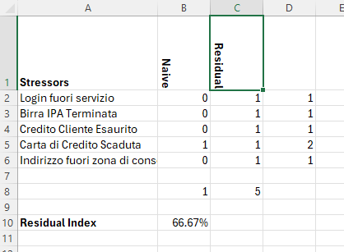
Residual Index

Slide 29
Thank You
alberto.acerbis@intre.it
https://github.com/BrewUp/ChaosAndResilience

